Slide 1
South Bow Tax Increment Finance District
Board of Selectmen public hearing
February 5, 2019

Slide 2
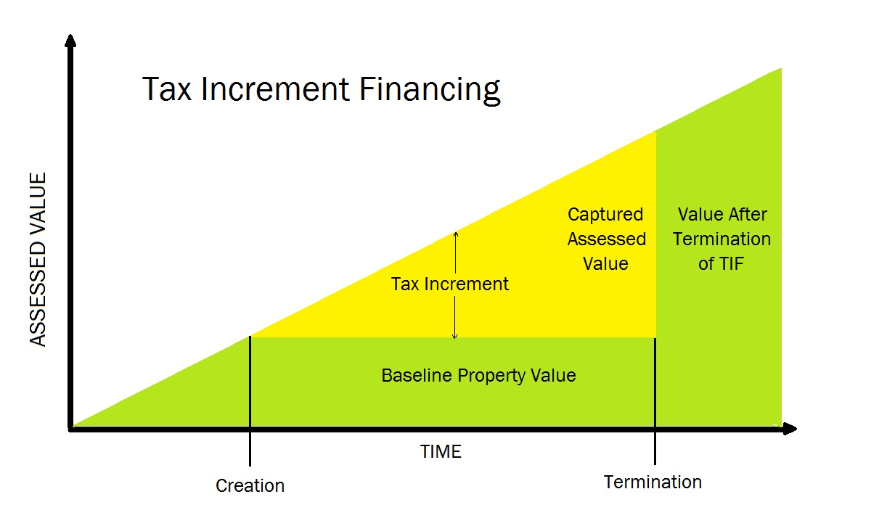
What is a Tax Increment Finance (TIF) District?
A TIF district is a way to fund infrastructure needed for new development without placing a burden on the existing tax base or current taxpayers.
Towns may set aside revenue generated from the increase in property values within a district for specific purposes.
Notes:
- Green is revenue that goes into General Fund

Slide 3
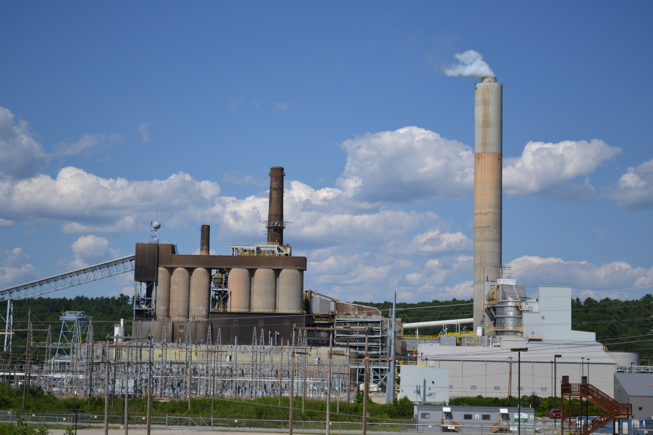
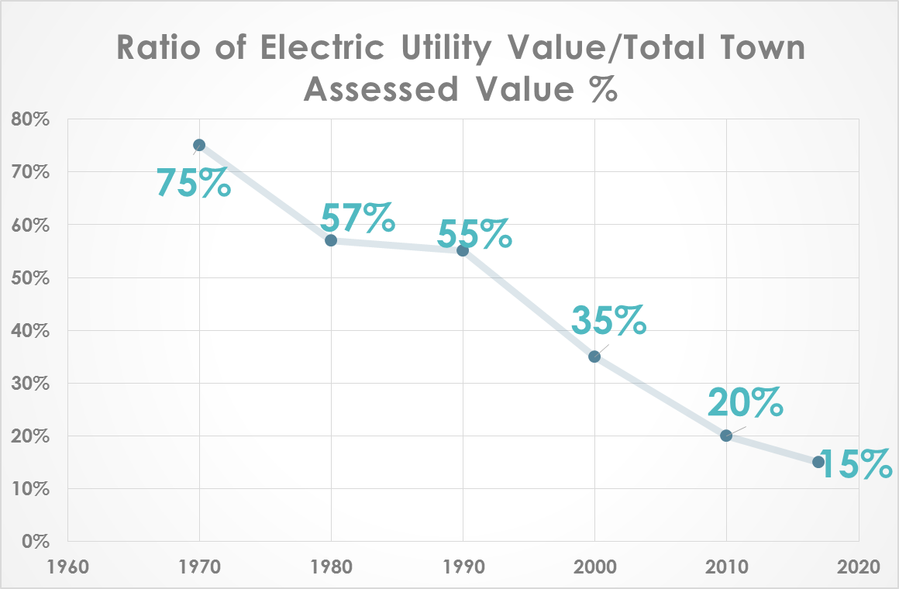
Why?
Diversify tax base;
Incentive for new business development;
Accelerate economic development.
Notes:
Elephant in the room!

Slide 4
Who is in Charge?
You are!
Town Meeting approval required for adoption and amendments;
2/3 majority Town Meeting approval required for projects to be bonded;
Board of Selectmen would serve as district administrator;
Committee would be established to advise Selectmen.

Slide 5
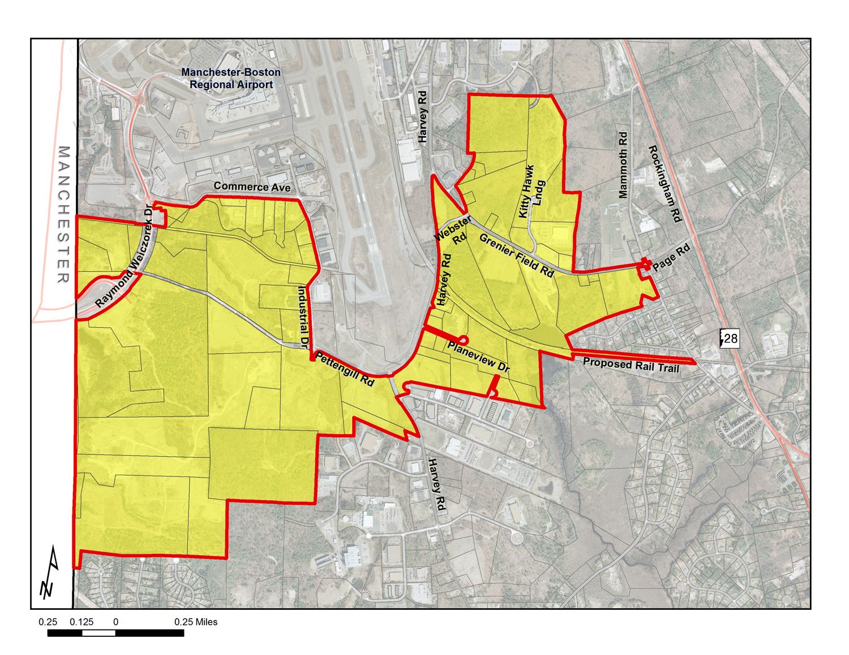
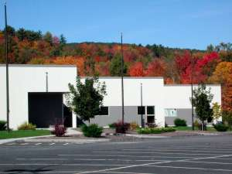
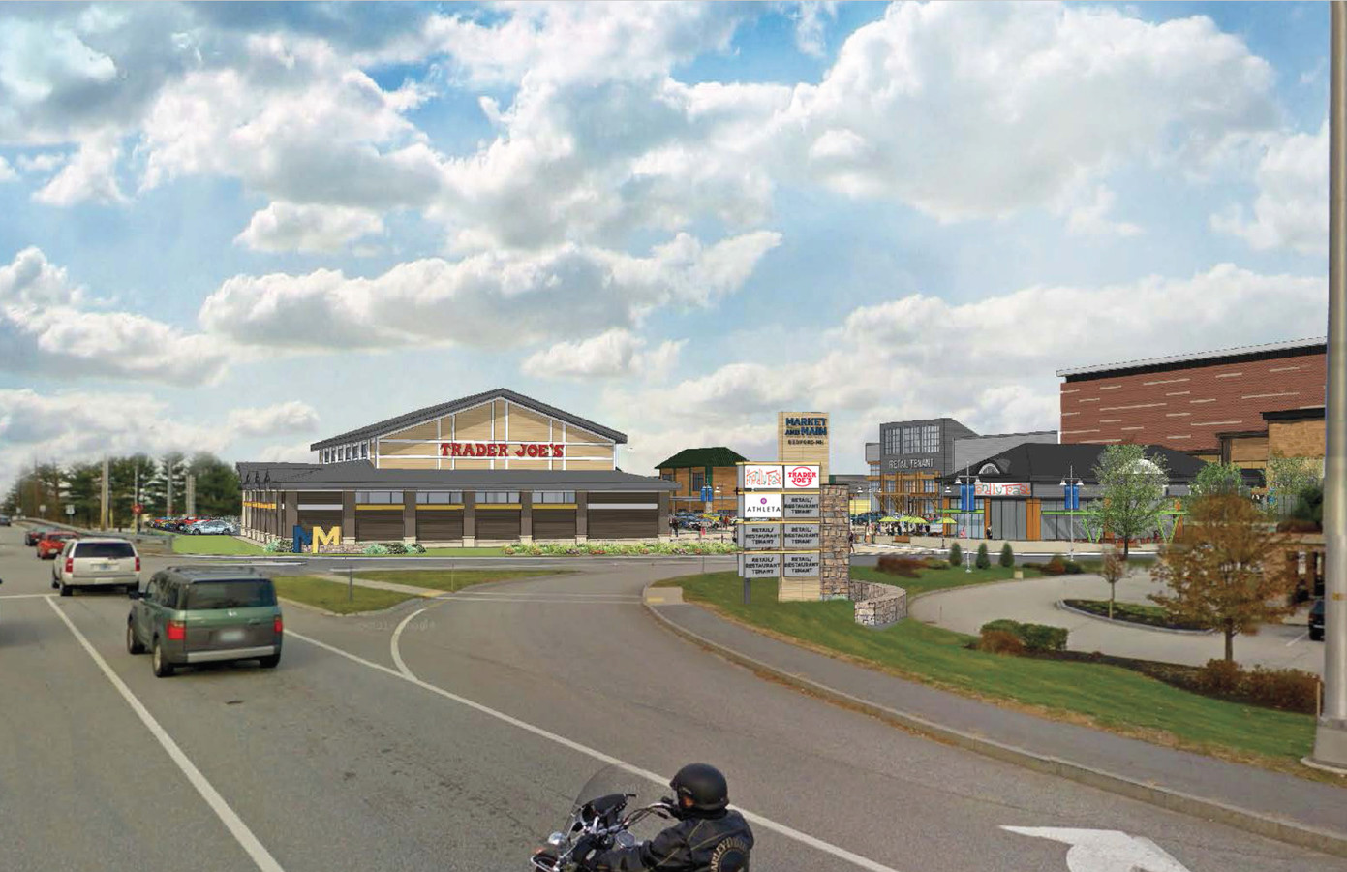
New Hampshire Examples
Londonderry | Concord
Keene | Bedford

Slide 6
New Hampshire Examples
Londonderry
Airport Area TIF established in 2013 to fund water, sewer, and construction of Pettengill Road;
Has added $177 million in assessed value;
Improvements funded by the TIF were paid off in 18 months;
New businesses include Pratt Whitney/UPS, Fedex, Milton CAT, and FW Webb.
Concord
North End Opportunity Corridor TIF established in 1997;
Over $50 million in value added;
New businesses include Grappone Center, Courtyard Marriott Hotel, Northeast Delta Dental, and Concord Hospital Urgent Care.
Keene
Black Brook TIF established in 1995 to fund improvements for a new corporate park;
Millions of dollars of assessed value added to tax base and over $20 million in additional tax revenue collected by 2000;
New businesses include Janos Technologies, C&S Wholesale Grocers, Smiths/Portex, and Precitech.
Bedford
South River Road TIF established in 2011 to fund road improvements;
Former Macy’s and Wayfarer Inn sites will accommodate multiple businesses once redevelopment is complete.
Millions of dollars of assessed value have already been added to the tax base;

Slide 7
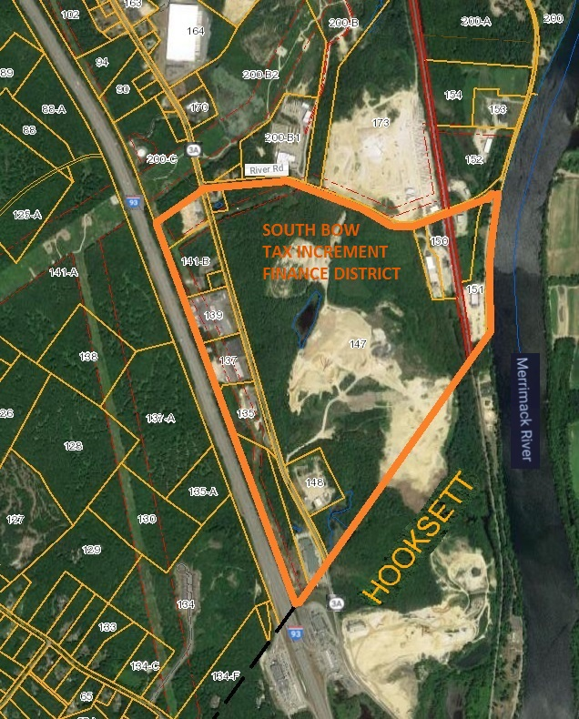
Proposed South Bow TIF District Map
Notes:
Extends from the intersection of Vaugn and River Roads north to City line.
Includes land recently rezoned.
Total 422 acres, about 2% of the Town’s total land area.

Slide 8
Proposed Improvements – WATER & SEWER
Extending water and sewer lines south approximately 5000 feet to Hooksett town line.
The total estimated cost for improvements in the district is $2,625,000.
Notes:
Exel, Matt Brown Trucking, Bow Auto, Berube Truck Accessories

Slide 9
Objectives
Bring public water and sewer to South Bow to support existing businesses and spur new development;
Provide an incentive for property owners and developers to convert current land uses to help expand the Town’s tax base;
Work cooperatively with the Town of Hooksett to interconnect the two towns’ respective water and sewer systems for the benefit of both towns.
Improve safety and access to Route 3A and accommodate economic development along the Route 3A Corridor
Improve the operation of the municipal water system by adding to the customer base and putting it on a path to self-sufficiency.
Notes:
Property in district has value of almost $80 million dollars and generates over $2 million a year in property tax revenue.
TIF is useful as an incentive but needed to help retain businesses as well.
ADD SEWER per consultant recommendation!

Slide 10
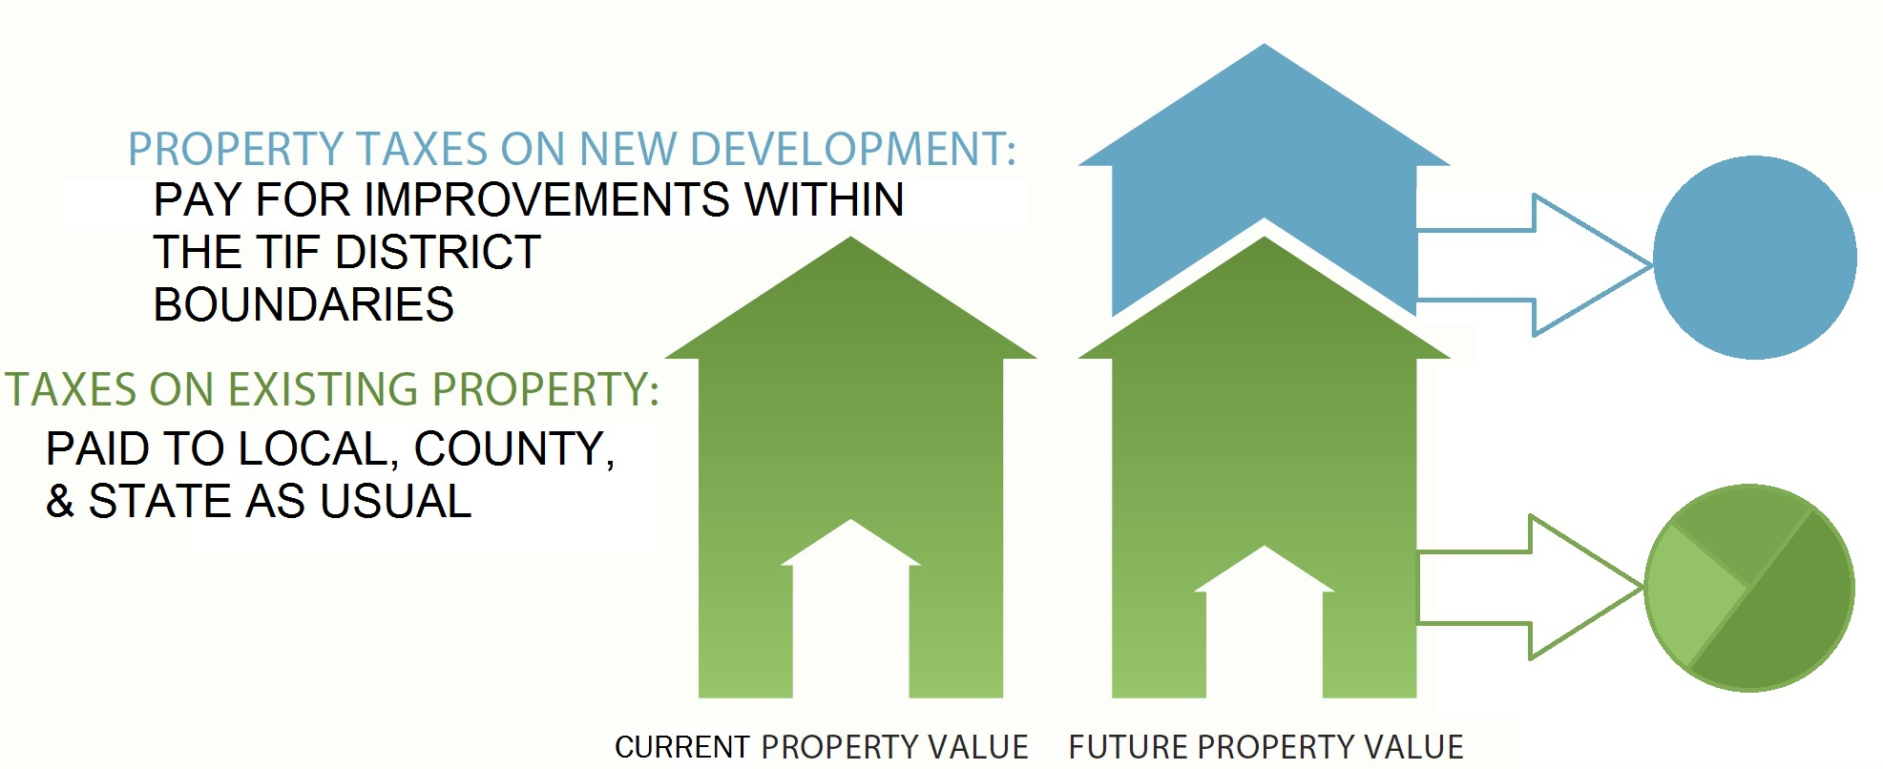
Finance Plan
Tax increment would be set aside for a maximum 20 years or until improvements have been paid off;
The town, county, and school district would continue to receive revenue from baseline assessments;
Prior to any town vote, a development agreement and performance guarantee would be in place to ensure improvements are fully funded with tax increment, grants, or private funds.
Notes:
$2 million plus revenue will continue to fund schools and community services.

Slide 11
Final Thoughts & Next Steps…
TIF district does not change zoning requirements or affect property rights;
Establishment of a TIF district does not increase taxes within or outside its boundaries;
Once improvements are paid for, all future revenue will go into the general fund;
The adoption of the TIF Plan is a non-monetary warrant article and does not require any expenditures by the Town.
A firm commitment from a developer to build will be required, with a guarantee that public improvements will be fully funded with increased tax revenue, private funds, or grants;
All work related to construction of improvements and development of site(s) will comply with local, state, and federal regulations.

Slide 12
Questions?
For more information please contact Matt Taylor, Bow Community Development Director:
Phone: 603-223-3971
Email: mtaylor@bownh.gov
or visit the Town website at www.bownh.gov

